Slide 1
UNIT 1: DC CIRCUITS
Lecture 4 and 5

Slide 2
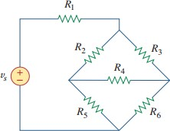
Star Delta Transformation
Situations often arise in circuit analysis when the resistors are neither in parallel nor in series. For example, consider the bridge shown in the figure.

Slide 3
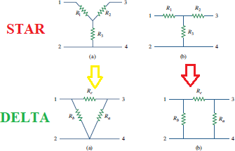
Star Delta Transformation
There are two types of such circuits
Star Connection
Delta Connection

Slide 4

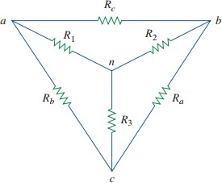


Delta to Star Conversion

Slide 5
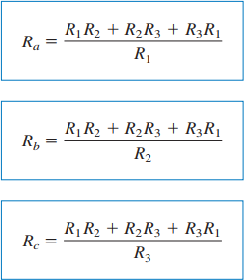
Star to Delta Conversion

Slide 6
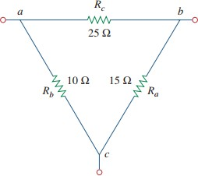
Practice Problem
Q: Convert ∆ network into a Y network?

Slide 7
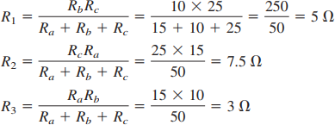
Practice Problem
Q: Convert ∆ network into a Y network?

Slide 8
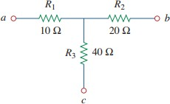
QUICK QUIZ (Poll 1)
Resistance 𝑅_{𝑏𝑐} for the ∆ network of the corresponding Figure is:
A. 140
B. 70
C. 35
D. 100

Slide 9
QUICK QUIZ (Poll 2)
Q: If 𝑅_{𝑎} = 𝑅_{𝑏} = 𝑅_{𝑐} = 𝑅 in a
∆ network , then 𝑅₁ = 𝑅₂ = 𝑅₃=?
3R
R/3
R
R/2

Slide 10
Energy Sources
Source
Voltage Source
Current Source
Independent
Dependent
Independent
Dependent
Voltage-Dependent
Voltage-Dependent
Current- Dependent
Current- Dependent

Slide 11
Independent and Dependent Sources
Independent sources are those which does not depend on any other quantity in the circuit. They are two terminal devices and has a constant value, i.e. the voltage across the two terminals remains constant irrespective of all circuit conditions. The Independent sources are represented by a circular shape.
Dependent or Controlled sources are those whose output voltage or current is NOT fixed but depends on the voltage or current in another part of the circuit. When the strength of voltage or current changes in the source for any change in the connected network, they are called dependent sources. The dependent sources are represented by a diamond shape.

Slide 12
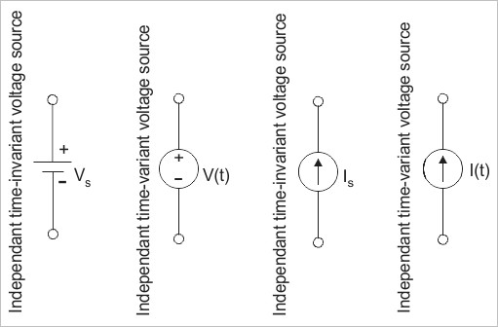
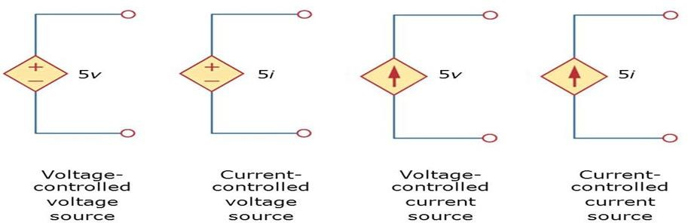
Independent and Dependent Sources
Independent • Dependent

Slide 13
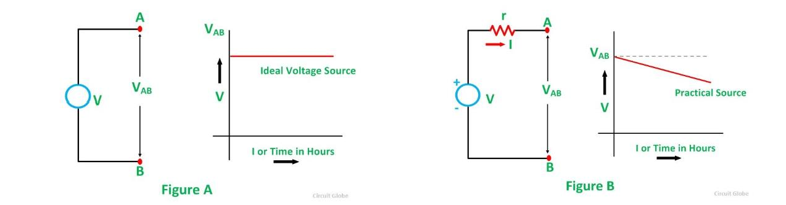
Ideal and Practical Voltage Source
Ideal is one where internal resistance does NOT exist. NOTE:
For a voltage source, internal resistance must be ZERO.
For a current source, internal resistance must be INFINITY.
Practical is one where internal resistance is present.

Slide 14
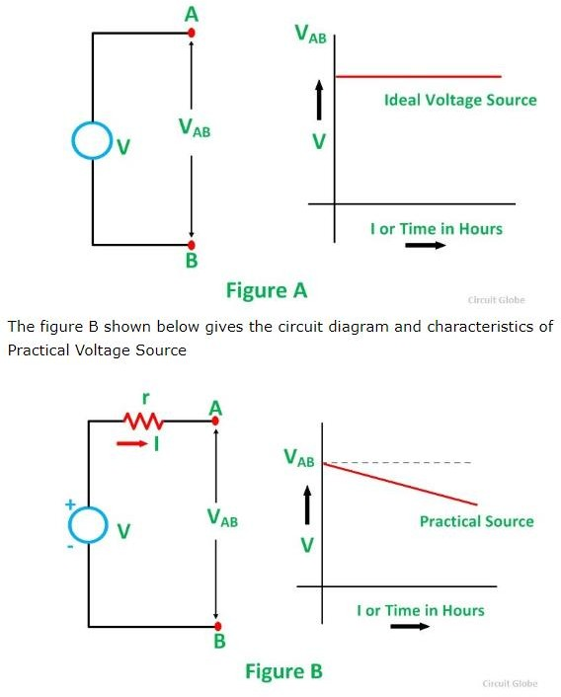
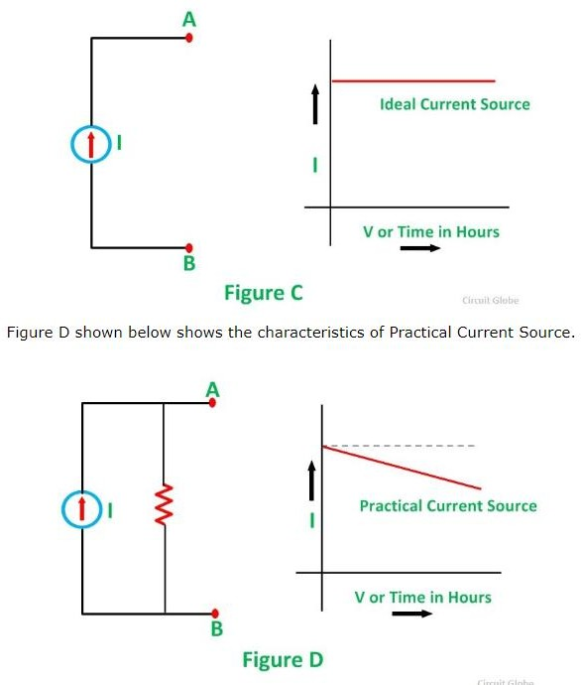

Slide 15
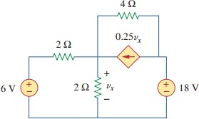
QUICK QUIZ (Poll 3)
Identify the type of dependent source used in the network:
VCVS
CCCS
VCCS
CCVS

Slide 16
Nodal Analysis
Nodal analysis provides a general procedure for analyzing circuits using node voltages as the circuit variables.
Choosing node voltages instead of element voltages as circuit variables is convenient and reduces the number of equations one must solve simultaneously.
Applicable to nodes only.
It is used to find the unknown node voltages.
This Method is Application of KCL+Ohm’s Law Only

Slide 17
Steps to Determine Node Voltages
Select one nodes out of ‘n’ node as the reference node. Assign voltages to the remaining nodes. The voltages are referenced with respect to the reference node.
Apply KCL to each of the non-reference nodes. Use Ohm’s law to express the branch currents in terms of node voltages.
3. Solve the resulting simultaneous equations to obtain the unknown node voltages.

Slide 18


The number of non-reference nodes is equal to the number of independent equations that we have to derive.
Current flows from a higher potential to a lower potential in a resistor

Slide 19
QUICK QUIZ
For “N” number of nodes, the number of non-reference nodes is equal to:
A. 𝑁 + 1
B. 𝑁 − 1
C. 2N
D. 2N − 1

Slide 20
QUICK QUIZ
Nodal analysis, which is based on KCL is used to find unknown:
A. 𝑐𝑢𝑟𝑟𝑒𝑛𝑡
B. voltage

Slide 21
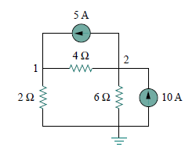
Example 1
Obtain the node voltages in the given circuit?

Slide 22
Mesh Analysis
Mesh analysis provides another general procedure for analyzing circuits, using mesh currents as the circuit variables.
It is based on KVL.
RECALL!
LOOP: A loop is a closed path with no node passed more than once.
MESH: A mesh is a loop that does not contain any other loop within it.
Mesh analysis is not quite as general as nodal analysis because it is only applicable to a circuit that is planar.
PLANAR CIRCUIT: A planar circuit is one that can be drawn in a plane with no branches crossing one another; otherwise it is nonplanar.

Slide 23
Steps to Determine Mesh Currents
Assign mesh currents to ‘n’ meshes
Apply KVL to each of the ‘n’ meshes.
Solve the resulting ‘n’ simultaneous equations to obtain the unknown mesh currents.

Slide 24
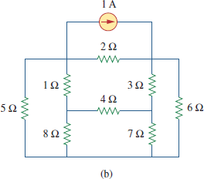
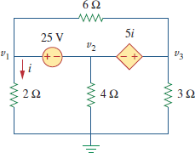
Examples of Planar Circuits
NOTE: A mesh is a loop which does not contain any other loops within it.
Mesh Analysis can be applied to meshes only inside the circuit, Not to LOOP.

Slide 25
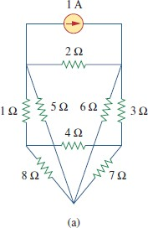
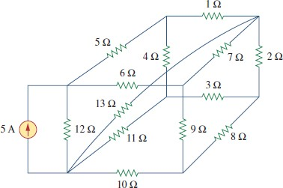
Examples of Non-Planar Circuits

Slide 26
QUICK QUIZ
Mesh Analysis to applicable to type networks.:
Planar and Loop
Non planar and mesh
Planar and mesh
Non planar and Loop

Slide 27
QUICK QUIZ
Mesh analysis, which is based on KVL is used to find unknown:
A. 𝑐𝑢𝑟𝑟𝑒𝑛𝑡
B. voltage

Slide 28
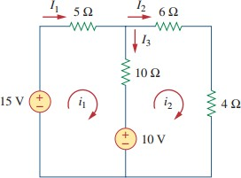
Example 1
Obtain the mesh currents in the given circuit?

